Slide 1
NXTPlayer

Slide 2
Parts

Slide 3
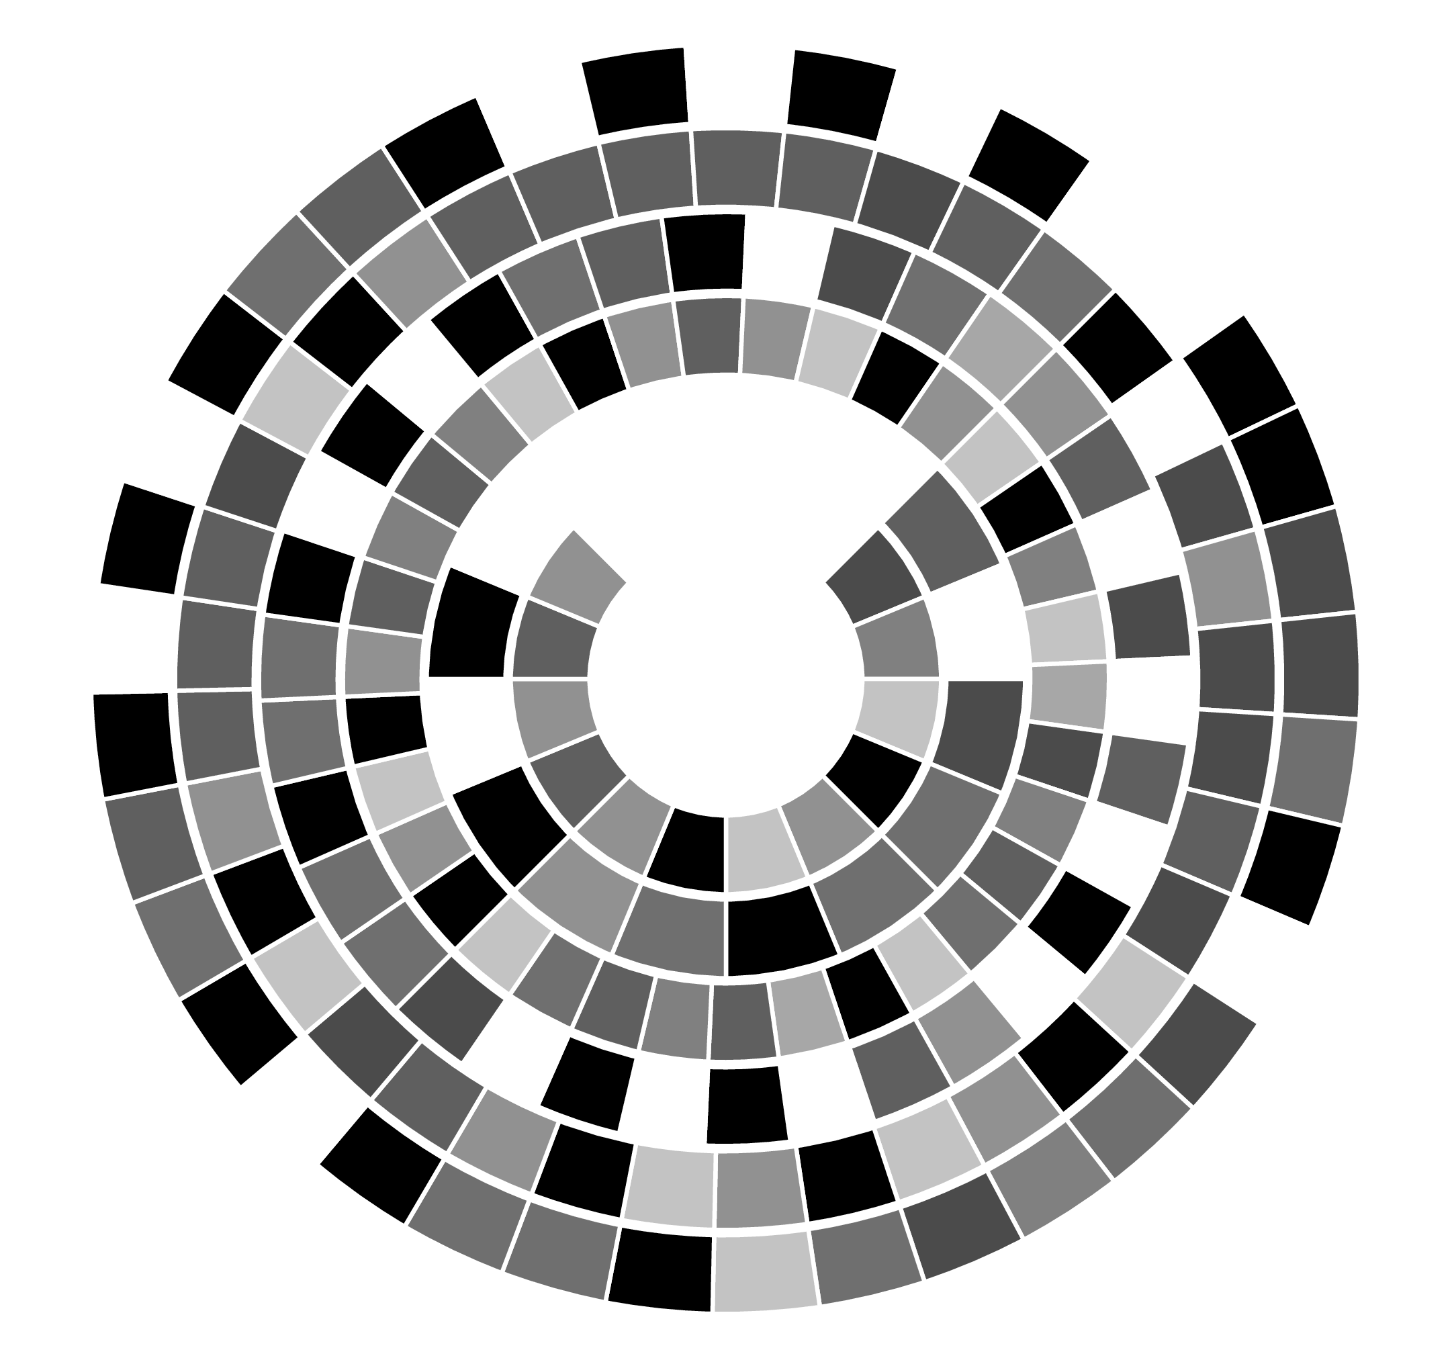
NXTDisk

Slide 4
NXTPlayer

Slide 5
NXTBurner

Slide 6
Note Structure

Slide 7

Color IDs
Color | ID
 | 0
 | 1
 | 2
 | 3
 | 4
 | 5
 | 6
 | 7
 | 8

Slide 8
Note Data Layout
Tone height
Base tone
Shifted
Octave
Duration
Pause
3 | 3 | 8
Frequency | Octave | White field
Modifier | Pause | Duration
7 | 4 | 4

Slide 9
Ton height (Frequency, Octave)
3 | 3 | 8
Frequenz | Oktave | Weißes Feld
Modifier | Pause | Tonlänge
7 | 4 | 4
3 | 3 | 8
Frequenz | Oktave | Weißes Feld
Modifier | Pause | Tonlänge
7 | 4 | 4
Half tones lie inbetween
1 Octave higher > Double frequency
Note | Frequency
‘C | 32,70 Hz
‘D | 36,71 Hz
‘E | 41,20 Hz
‘F | 43,65 Hz
‘G | 49,00 Hz
‘A | 55,00 Hz
‘H | 61,74 Hz

Slide 10
Duration, Pause
3 | 3 | 8
Frequenz | Oktave | Weißes Feld
Modifier | Pause | Tonlänge
7 | 4 | 4
3 | 3 | 8
Frequenz | Oktave | Weißes Feld
Modifier | Pause | Tonlänge
7 | 4 | 4
ID | Duration
0 | -
1 | Ganze
2 | Halbe
3 | Viertel
4 | Achtel
5 | Sechzehntel
6 | Punktierte Viertel
7 | Punktierte Achtel
8 | Punktierte Sechzehntel

Slide 11
Modifier
3 | 3 | 8
Frequenz | Oktave | Weißes Feld
Modifier | Pause | Tonlänge
7 | 4 | 4
3 | 3 | 8
Frequenz | Oktave | Weißes Feld
Modifier | Pause | Tonlänge
7 | 4 | 4
Saves extra information about the note
ID | Meaning
0 | Nothing
1 | Play back normally
2 | Loop Marker
3 | Repeat 2 times
4 | Repeat 3 times
5 | Repeat 4 times
6 | Repeat 5 times
7 | Increase by a half tone
8 | End of track

Slide 12
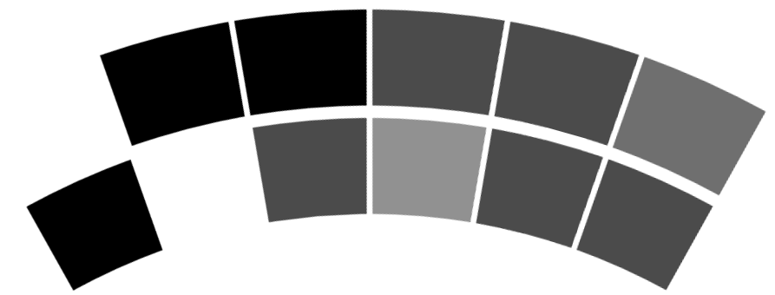
Disk ID
Calibration
Beats per Minute
Base-Octave
Buffer

Slide 13
Base 9 to base 10 and back
1 | 1 | 3
93 Bpm
93 Bpm
1 | 1 | 3

Slide 14
Transition problems
1
2
0

Slide 15
Transition problems
6
5
4
0

Slide 16
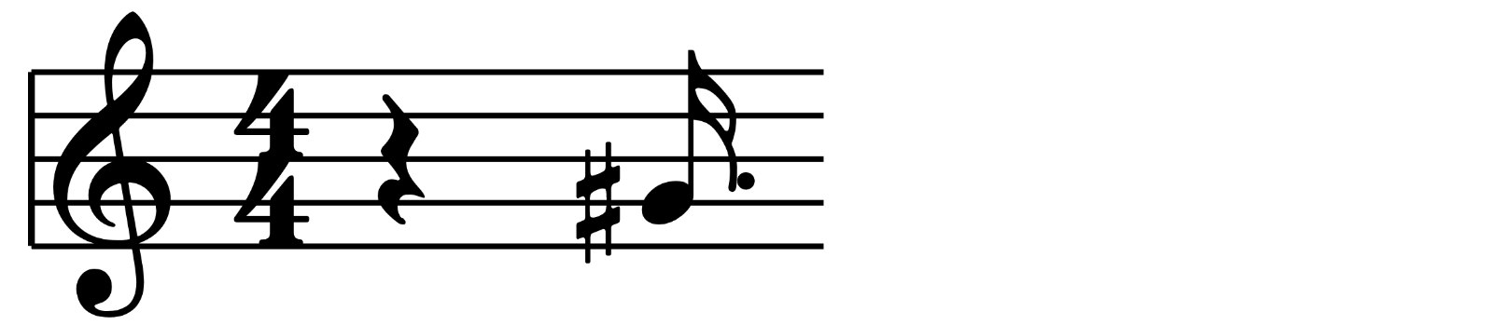
Example note
Frequency: 6
Octave: 2 (Default: 5)
Modifier: 7
Pause: 0
Duration: 8
6
Frequency
2
Octave
8
White
Modifier
7
Pause
0
Duration
8

Slide 17
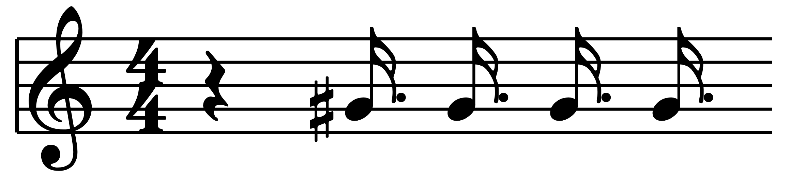
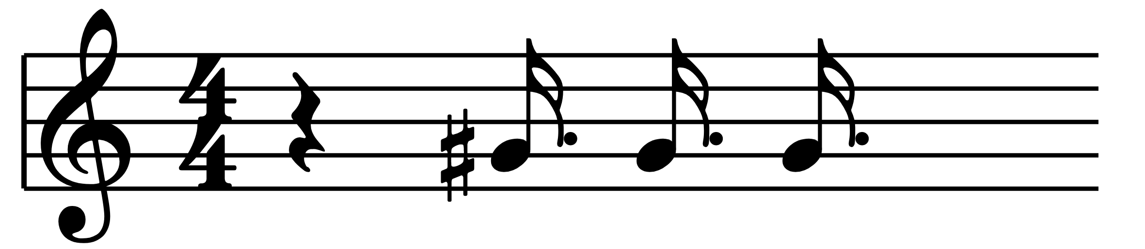
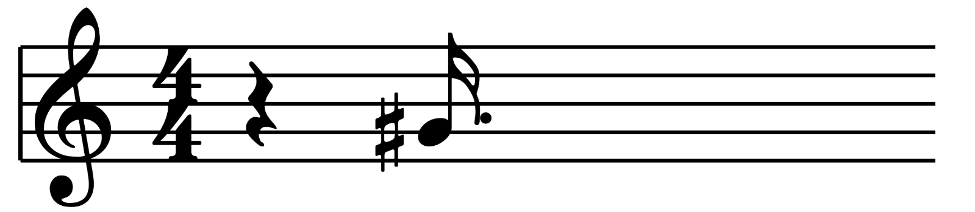
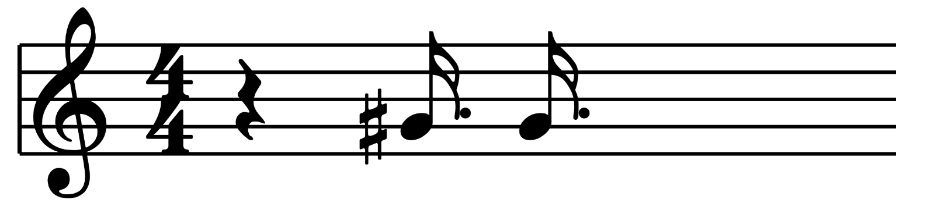
Example note
Frequency: 6
Octave: 2 (Default: 5)
Modifier: 7
Pause: 0
Duration: 8
6
Frequency
2
Octave
4
Alt Modifier
8
Weißes Feld
Modifier
7
Pause
0
Duration
8

